Slide 1

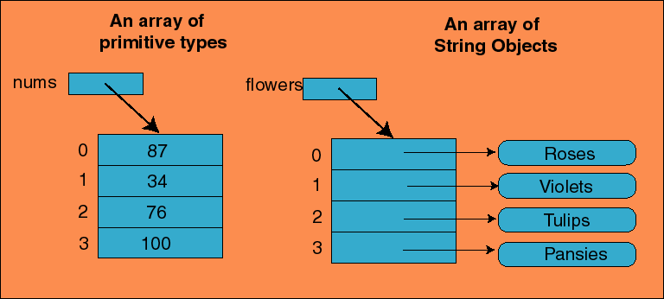
Chapter 6: Arrays of Objects
http://www.willamette.edu/~gorr/classes/cs231/lectures/chapter9/

Slide 2

Arrays are objects
Arrays of objects
not covered from chap. 6:
  enumerated types (p. 387-394)
  methods with variable number of parameters (p. 374-377)

Slide 3

The elements of an array can be:
  a primitive type or
  an object reference
In Java, the array itself is an object
  so the name of the array is a reference
  and the array itself must be created with new

Slide 4


In Java, an array is an object
  so an array can be passed as a parameter to a method
Like any other object:
  the reference to the array is passed (much faster)
  so the formal and actual parameters become aliases of each other
  so changing an array element within the method changes the original object
passing the entire array ≠ passing a single element of the array

Slide 5


public boolean isVowel(char someChar) {
}
public int nbVowel(char[] someCharArray) {
}
char[] alphabet = {'a', 'b', 'c', 'd, …, 'z'};
if (isVowel(alphabet[0])) // ok ?
System.out.print(“…");
if (isVowel(alphabet)) // ok?
System.out.print("…");
if (nbVowel(alphabet)>3) // ok?
System.out.print("…");
if (nbVowel(alphabet[4])>3) // ok?
System.out.print("…");

Slide 6
Write a method that will return the sum of an array of integers.

Slide 7

we cannot change the size of an array
but we can assign an array to another…
int[] a1 = {10, 20, 30};
int[] a2 = {1, 2, 3, 4, 5};
System.out.println(a1.length);
System.out.println(a1[0]);
a1 = a2;
System.out.println(a1.length);
System.out.println(a1[0]);
Output

Slide 8

to copy the content of an array into another:
or use the built-in clone method (for 1-d arrays)
  note: clone returns an array to a generic Object, we need to cast the result to what we want (ex. int[])
static int[] duplicate(int[] theOriginal) {
int[] theCopy = new int[theOriginal.length];
for (int i = 0; i < theOriginal.length; i++)
theCopy[i] = theOriginal[i];
return theCopy;
}
theCopy = (int[]) theOriginal.clone();

Slide 9

public static void main(String[] args) {
int[] a1 = {10, 20, 30};
int[] a2 = {1, 2, 3, 4, 5};
System.out.println(a1[0]);
// a1 = a2;
// a1 = duplicate(a2);
// a1 = (int[]) a2.clone();
System.out.println(a1[0]);
a1[0] = 99;
System.out.println(a1[0]);
System.out.println(a2[0]);
}
public static int[] duplicate(int[] theOriginal) {
int[] theCopy = new int[theOriginal.length];
for (int i = 0; i < theOriginal.length; i++)
theCopy[i] = theOriginal[i];
return theCopy;
}
with: a1 = a2;
with: a1 = duplicate(a2);
with: a1 = (int[]) a2.clone();
Output

Slide 10

a method may also return an array
  public static int[] incrementArray(int[] a, int increment)
  {
  int[] temp = new int[a.length];
  int i;
  for (i = 0; i < a.length; i++)
  temp[i] = a[i] + increment;
  return temp;
  }

Slide 11

If an accessor returns the contents of an array, special care must be taken
  Just as when an accessor returns a reference to any private object
  public double[] getArray()
  {
  return anArray;//BAD! privacy leak
  }

Slide 12
The method should return a reference to a deep copy of the private array object
  public double[] getArray()
  {
  double[] temp = new double[count];
  for (int i = 0; i < count; i++)
  temp[i] = a[i];
  return temp
  }

Slide 13

we can have arrays of primitive types
we can have arrays of objects (more precisely, arrays of references to objects)
1 | 2 | 10 | 6 | 25
'a' | 'd' | 'e' | 'z' | 'f'

Slide 14

ex: 5 references to String objects
String[] words = {"I", "am", "very", "hungry", "!"};
“I”
“am”
…
…
“!”

Slide 15

create the array of references
create each object
Each object in the array must be created individually
manipulate each object
Account[] bank = new Account[3];
bank[0] = new Account("ted", 111, 100);
bank[1] = new Account("mary", 222, 500);
bank[2] = new Account("john", 999, 5);
for (int i = 0; i < bank.length; i++) {
bank[i].deposit(100));
System.out.print(bank[i].getBalance());
}

Slide 16
Declare the class Airplane with speed, nbPassengers, Pilot.
Declare an array of 100 Airplane objects

Slide 17
write a method that takes an array of Airplane and returns the average speed of the Airplane . If the array is empty, return 0.

Slide 18
public class Telephone {
private int number;
public Telephone(int number) {
this.number = number;
}
public String ring() {
return "dring dring";
}
}
Declare a 2-D array of 10x10 Telephone objects.
Initialize each of the 100 telephone objects to the phone number (514) 848-2424.
Call the method ring on all 100 elements of the array and display the result.

